Slide 1
托福写作
许海燕

Slide 2
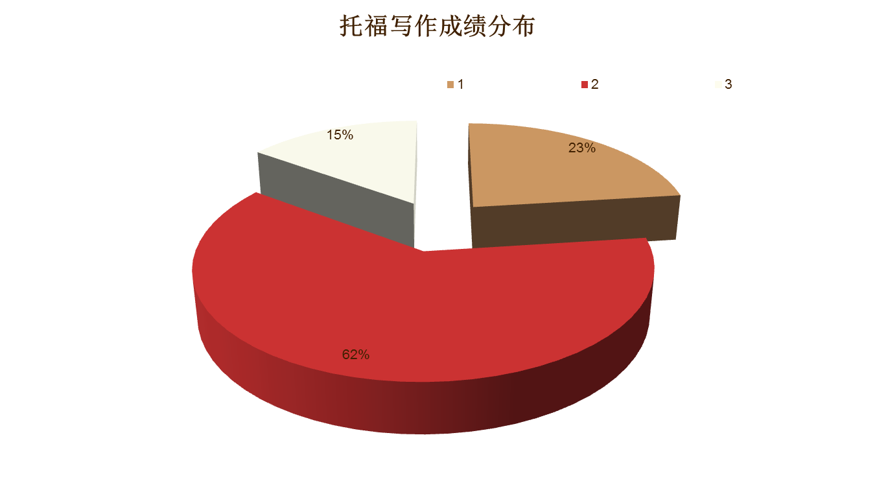

Slide 3
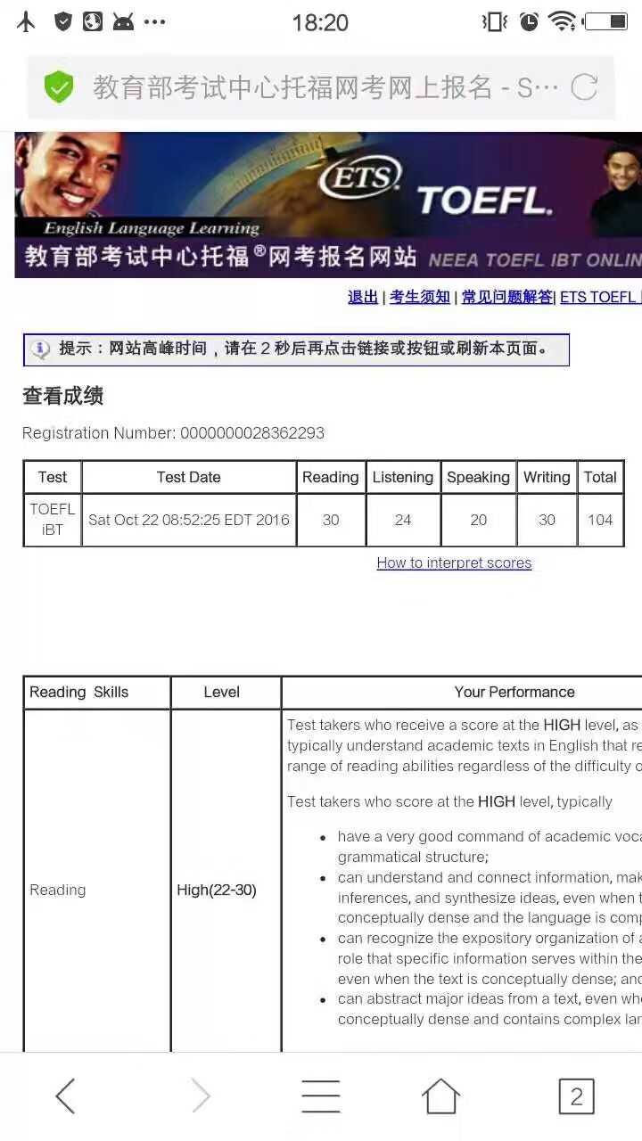


Slide 4
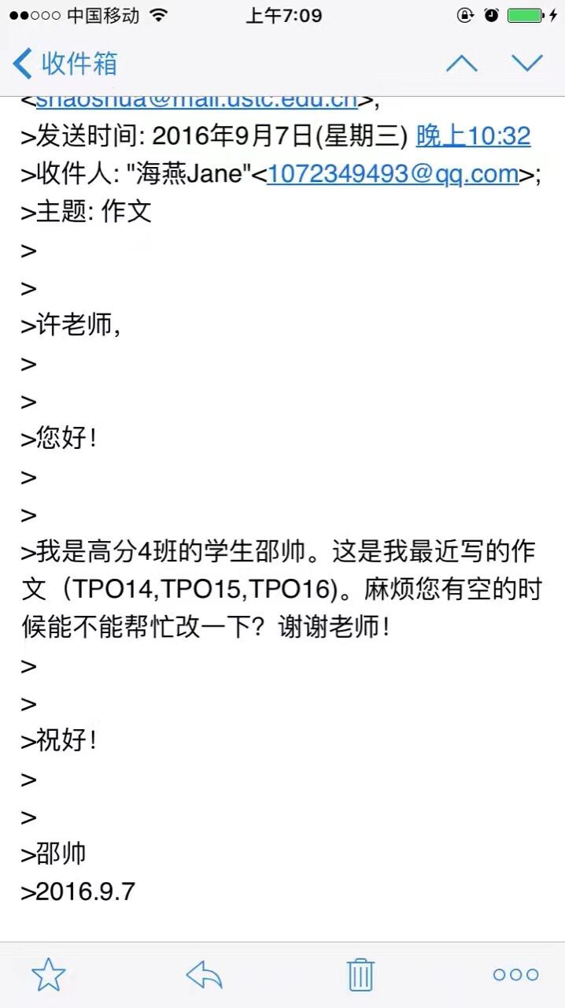
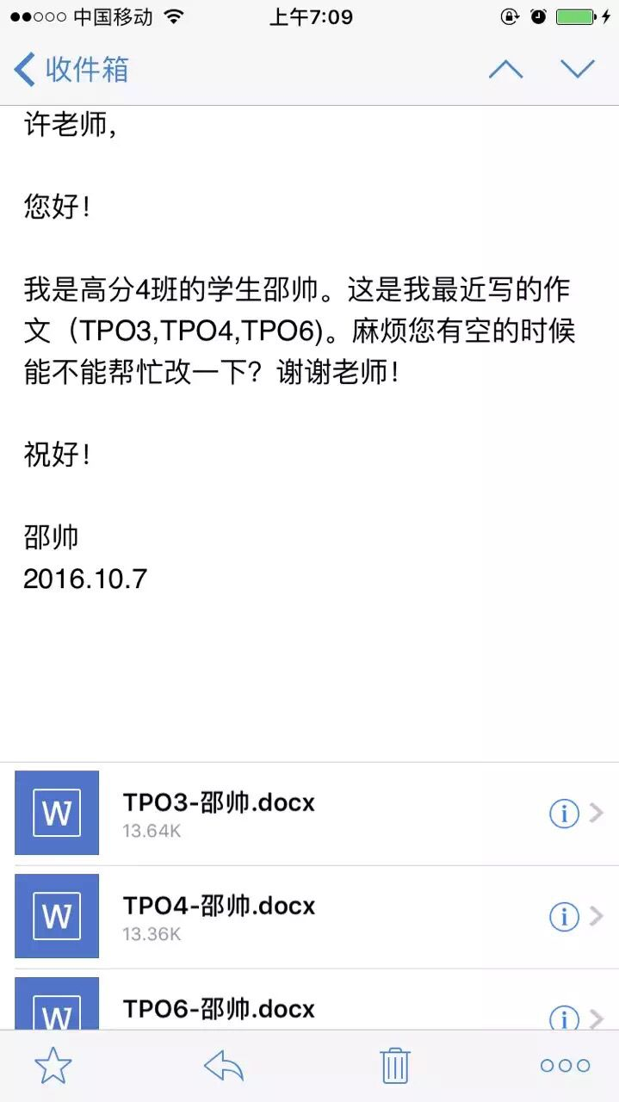

Slide 5

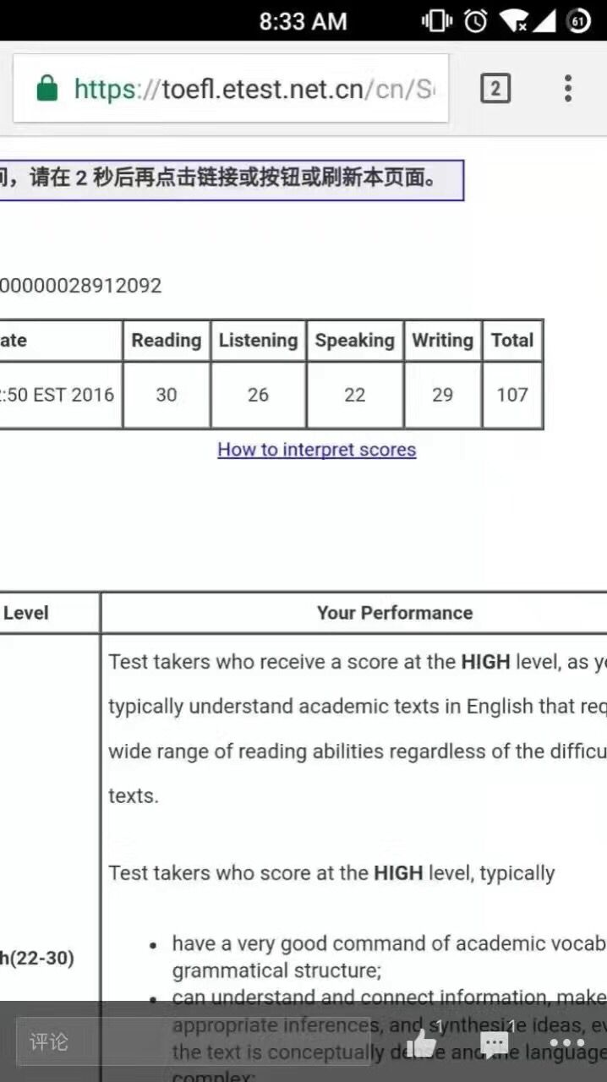

Slide 6




Slide 7
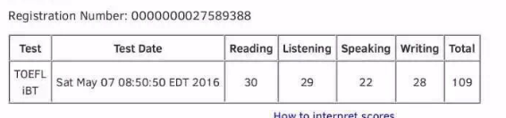
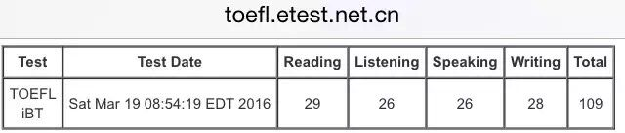
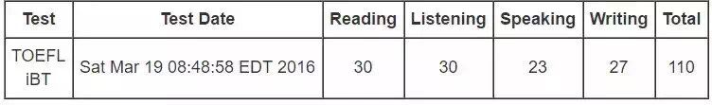

Slide 8
托福独立写作评分标准
1. effectively addresses the writing task
2. is well organized and well developed
3.uses clearly appropriate details to support a thesis
4.displays consistent facility in the use of language
5.demonstrates syntactic variety and appropriate word choice, though it may have occasional errors.
*⼈人批&机器批?

Slide 9
1.有效地针对话题完成任务（不跑题）
例1：Agree or disagree:spendingg too much time on watching sports on TV and following your favorite team would have a bad effect on your life.
例2：Nowadays, it is much easier for a person to achieve success without family's help than in the past.

Slide 10
2）+3）能充分展开，结构清晰；使用适当的解释和例证
主题句：环境保护有利于经济发展
说理论证：环境好1)招商引资;2)推动旅游业
细节例子：新加坡（或你所居住的城市）

Slide 11
1)主题句：英语是国际性语言
2）解释：因为英语大国很发达，主导世界，其他国家为了学习其先进文化和科技，鼓励学英语，客观上使得英语成为国际通用语言。
3）例证：去日本旅游，可以用英语沟通。

Slide 12
4）连贯性（形式上和内容上） *形式上：transitional words：
逻辑连接词（段落，句间，句内）
段落：first, moreover, however, in sum
句间：因果，对比，让步，目的，举例

Slide 13
内容上：指代、重复
My view is that young people should be encouraged to broaden their horizons.That is the best way for them to get a clear perspective of what they are hoping to do with their lives and why.Students with such a perspective are usually the most effective and motivated ones and taking a year off may be the best way to gain this.
Over the last half century the pace of change in the life of human beings has increased beyond our wildest expectations.This has been driven by technological and scientific breakthroughs that are changing the whole way we view the world on an almost daily basis.This means that change is not always a personal option, but an inescapable fact of life, and we need to constantly adapt to keep pace with it.

Slide 14
5. 句式丰富，措辞合适，允许小的错误
1）句式变化： 形式主语、存现句、各种从句、后置定语、 人为主语、物为主语、倒装、分词做状语、动词名词化、 插入句等（*美国留学是我的梦想；*备考托福的过程提升英语能力*旅游业最近几年发展不错。)
Studying in the US is my dream.
I dream of studying in the US.
My dream of studing in the US take roots in my heart.
The period when I was preparing for TOEFL saw a dramatic rise in my English.
Tourism has witnessed an unprecedented boom in recent years.
witness 见证 unprecedented adj. 空前的，史无前例的 boom n. 繁荣 booming tourism 蓬勃的旅游业

Slide 15
2）措辞合适：
1. 大学校的学生可以接触到好的老师和很多教学资源。
Students in a larger university can touch good professors and many teaching resources.
Students in a larger university have access to excellent professors and abundant teaching resources.
access 接近 have access to... 有接触……的机会，可以利用

Slide 16
2. 由于社会竞争激烈，如今父母非常重视孩子的教育。
Because social competition is serious, nowadays parents value children’s education very much.
Due to the fierce competition in society, nowadays parents attach great importance to children’s education.
attach 贴，附 attach importance to 重视

Slide 17
3. 我们应该利用在学校中的每一天，因为人生中的这一重要时期 有助于未来成功。
We should use every single day spent on campus, because this crucial period in life is good for future success.
We ought to make full use of every single day spent on campus, because/ as/ since/ for this crucial period in life definitely constitutes a stepping stone to future success.
充分利用: make full use of/ make the most of /take full advantage of a stepping stone 垫脚石
constitute a stepping stone to success 有助于成功，为成功奠 定基础

Slide 18
3)允许小的错误（最好不好出现）
词性的选择、词语的搭配和单词的拼写要正确
during the process of children's grown
Defective information may be offered from the internet.
However, others argue that school is the place where children can learn the way to be a good number of the society.

Slide 19
英美拼写问题以及缩写
（1）-re与-er
中心 戏院
（2）-our和-or
丰富多彩的 劳动
（3）-ise,-isation与-ize,-ization
意识到 组织，机构
（4）-ce与-se
执照 防守
（5）英式在美式拼写中被简化
节目 旅行者

Slide 20
中国学生最易犯的七类语法错误
第一类
1.Employee can get more benefits from telecommuting(远程上班) than employer.
第二类
2. Work at home using modern technology can greatly enhance our efficiency.
3Children who are raise in impoverished families can generally deal with problems more effectively in their adult years.
4. The problems that are created by environmental contamination is very hard to resolve.
5. Many students are like studying home economics.
6. Cultures around the world were becoming increasingly similar today.

Slide 21
第三类
6. Intelligent students should not be treated different by their teachers.
第四类
7. Countries should pay attention on the disadvantages globalization may create.
8. The internet has instead of teachers in many classrooms.
第五类
9. Some parents do not obey traffic rules himself.

Slide 22
第六类
10. Some people think the Internet only has positive impact, other people believe it also has negative influence on our lives.
第七类
11. There are many parents think that the main purpose of education should be to provide children with knowledge.

Slide 23
句子层面
破句
破句是把不完整的句子当作独立的句子来写时发生的错误。
Students should be encouraged to take part-time job. Because it will benefit students and their family, even the society as a whole.
International travel has given rise to large numbers of employment opportunities. For example, retail, hospitality and transportation.
Many sociologists point out that rural emigrants are putting pressure on population control. And also threatening to take already scarce city jobs.

Slide 24
3、错误的平行结构
1.一系列平行结构上的不正确使用
Many people choose air transportation because it is fast, offers convenience and it is not very expensive.
2逻辑上的不一致
The percentage of cancerous persons among smokers is significantly higher than non-smokers.

Slide 25
首段写作详解
第一步：引子
例题：Do you agree or disagree with the following statement? Parents should encourage their children to care for an animal.
要素：（）（）（）（）
现象法

Slide 26
现在，越来越多的孩子在家里养宠物。
Nowadays， more and more children are raising pets in their families.
不难看到孩子们和他们的家长在小区公园遛狗。
It is not rare to see children walking dogs with their parents in community parks.

Slide 27
题目：The most important investment that can be made to the education of children aged four to seven is giving them a computer.
背景法：
1. 关键词 investment of education giving children(4-7) a computer
2. 对象
3. 前因后果 attach importance to

Slide 28
背景法： Nowadays, due to fierce competition in society, parents attach greater importance to children’s education, thus providing their children with learning tools. //Some people claim that a computer is the preferred option, as children could have access to various study resources to enrich their knowledge with it.

Slide 29
Q：Living in big cities is a better choice.
Everyone has different dreams when it comes to where they wish to live. Some people think that living in a small town is desirable, while others choose city life. Personally, I would prefer to live in a large city. I feel this way for two reasons, which I will explore in the following essay.

Slide 30
练习
Only movies that can teach us something about real life are worth watching.
随着人们生活水平的提高，看电影似乎成为人们生活中不可或缺的一部分，因为电影不仅仅能娱乐观众，更能使之受到启发。
With remarkable progress of people's living standard, watching movies seems to be an indispensable part of people's life, as movies not only entertain the viewers but also enlighten them.

Slide 31
government should focus its budgets more on environmental protection than on economic development.
过去的几十年见证了全球经济的蓬勃发展。摩天大楼、便捷的通信、快速的交通让人们更舒适更方便地生活在这个星球上。但是，人们开始意识到如今的伟大成就似乎伴随着对环境的破坏。他们声称政府应该把更多的预算关注到环境保护上而不是经济发展上。对于我而言，。。。
the past several decades have witnessed that the world's economy is booming. modern skyscrapers, convenient communications, fast transportations make it easier and cozier for people to live in this planet. however, people are beginning to realize that the great achievements today seem to be at the price of destroying the nature. they claim that governments should focus its budgets more on environment than on economic development. as for me,...

Slide 32
第二步：转述题目
推荐句型：
Whether...has been a topic/ an issue of public interest and concern. (主语从句)
People have not reached a common idea whether...(同位语从句)
是否家长们应该允许孩子们养宠物是一个备受争议的话题。
家长们在是否让孩子养宠物这一问题上没有达成一致的意见。

Slide 33
第三步：观点
提出他人看法的句型：
Some people assert/argue/assume/believe that...(宾语从句)
Some people hold the idea/point of the view that...(同位语从句)
Others hold the opposite opinion that...(同位语从句)
阐明自己观点的句型：
Personally, I prefer the former(latter) opinion.
In my opinion/from my perspective, the first(second) point of view is more convincing.
Frankly, the former(latter) standpoint, I believe, is more acceptable.

Slide 34
第四步：铺垫
1）纯粹起引导作用
2）既起引导作用又有实际内容
As for me, I agree with the latter, especially when the following reasons are considered.(起引导作用，无实际内容)
Frankly, the latter viewpoint, I believe, is more acceptable, especially when its potential impact on children’s health and its possible influence to their studies are taken into consideration.(起引导作用，又有实际内容)
Based on the potential impact this has for doing harm to children’s health and studies, I prefer the latter opinion.

